Slide 1



Unsupervised Correction of Training Labels
project taken under program
Presented by:
Charmi Chokshi
Final year BTech student of
Information and Communication Technology
Ahmedabad University
Duration: May 31, 2018 to July 23, 2018
Guided by:
Mr. Pankaj Bodani (Scientist-SE)
Space Application Centre-ISRO

Slide 2
Outline
Objectives
Introduction
Methodology
Unsupervised Image Segmentation Algorithms
Discussion
Region Growing Algorithm
Conclusion
Future work
References

Slide 3
Objective
To work on the preprocessing (Data Cleaning) step of the image segmentation problem using Deep Learning
To create accurate Training Labels as the input to Neural Network
To apply unsupervised image segmentation techniques on raw satellite images of different cities to differentiate between urban and non-urban area
To analyse different algorithms and find the most appropriate for our dataset

Slide 4
Introduction

Slide 5
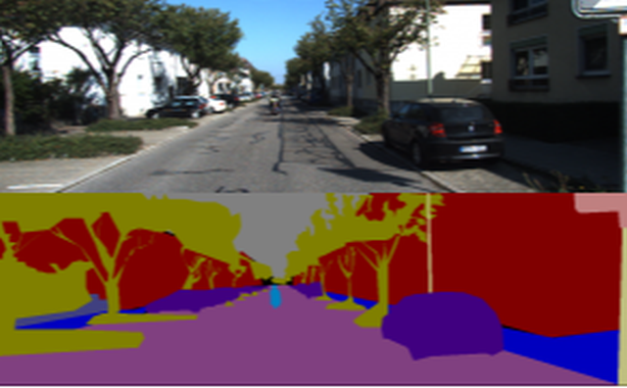
What is Image Segmentation?
In computer vision, image segmentation is the process of partitioning a digital image into multiple segments
Image segmentation is typically used to locate objects and boundaries in images.
More precisely, it is the process of assigning a label to every pixel in an image such that pixels with the same label share certain characteristics

Slide 6
Application of Image Segmentation
Driverless car
Medical imaging
Object detection
Face detection
Pedestrian detection
Brake light detection
Locate objects in satellite images (roads, forests, crops, water bodies, etc.)
Recognition Tasks
Traffic control systems

Slide 7
What is Unsupervised Image Segmentation?
Unsupervised = Learning without the help of teacher!
No Labeled Training Data available for the model to learn from
The goal of this unsupervised machine learning technique is to find similarities in the data point and group similar data points together which will give us insight into underlying patterns of different groups
“Clustering” is the process of grouping similar entities together
Supervised Segmentation
Input: Raw image, Ground Truth
Output: Segmented Image
Unsupervised Segmentation
Input: Raw image
Output: Segmented Image

Slide 8
Methodology
Methodology consist of following 2 stages:
Unsupervised image Segmentation using Clustering algorithms
Post-processing using Seed based Region Growing algorithm
Input Satellite Data
Satellite: IRS Resourcesat–2
Sensor: LISS-IV
Spatial Resolution: 5.8 m
No of Bands: 3
Bit depth: 16 (65536 different tones can be assigned to a pixel)
Cities: Vadodara, Jabalpur, Sagar, Satana, Ujjain, Varanasi, Rampur

Slide 9
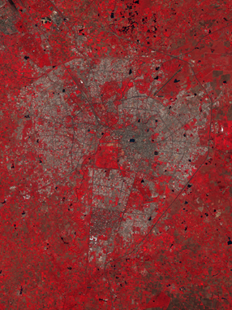
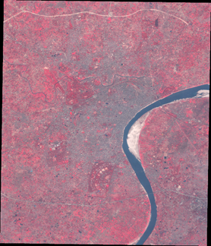
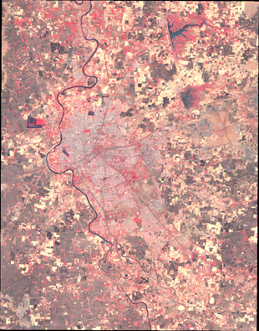
Input Images
Vadodara Varanasi Ujjain

Slide 10
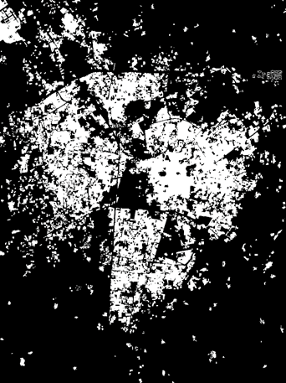
Raw and Ground Truth Images

Slide 11
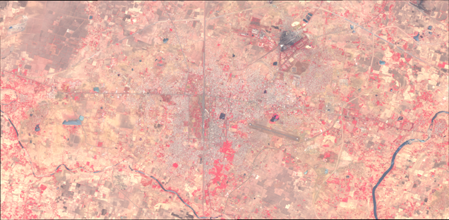
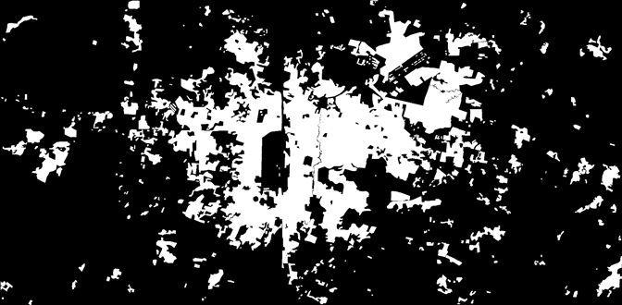
Raw and Ground Truth Images

Slide 12
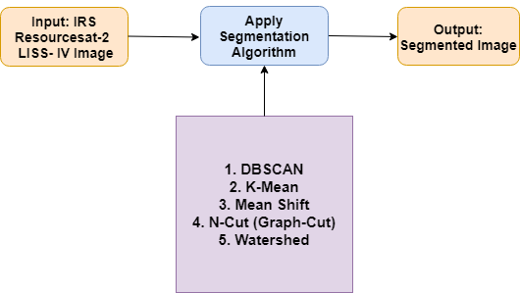
Methodology of step-1

Slide 13
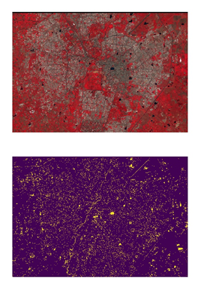
DBSCAN
DBSCAN: Density-based spatial clustering of applications with noise
It is a Density based image clustering algorithm whose clusters are defined as areas of higher density than the remainder of the data set
It clusters water bodies accurately in our dataset
DBSCAN(eps=0.5, min_samples=5, metric=’euclidean’, n_jobs=1)
eps: The maximum distance between two samples for them to be considered as in the same neighborhood.
min_samples: The number of samples (or total weight) in a neighborhood for a point to be considered as a core point. This includes the point itself.

Slide 14
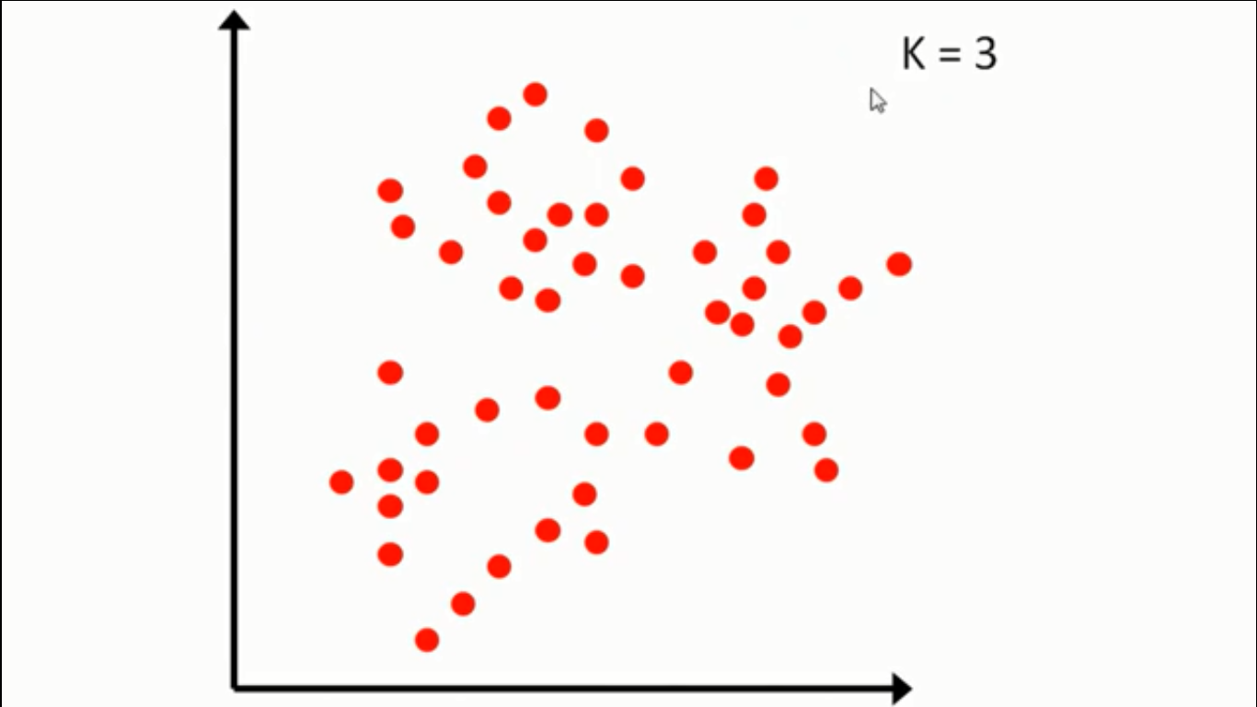
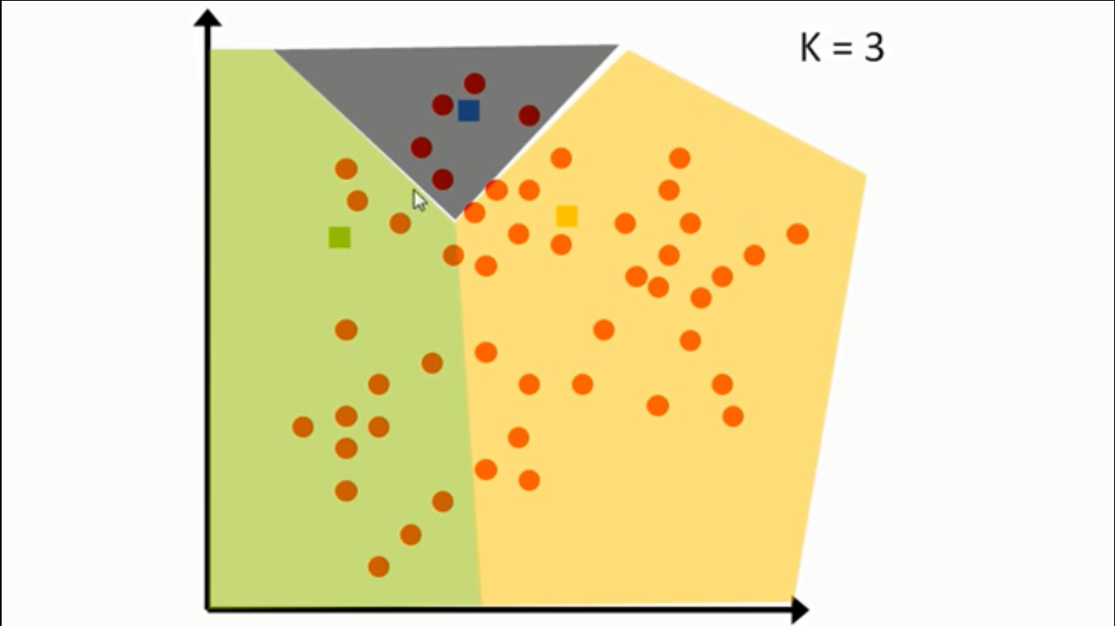
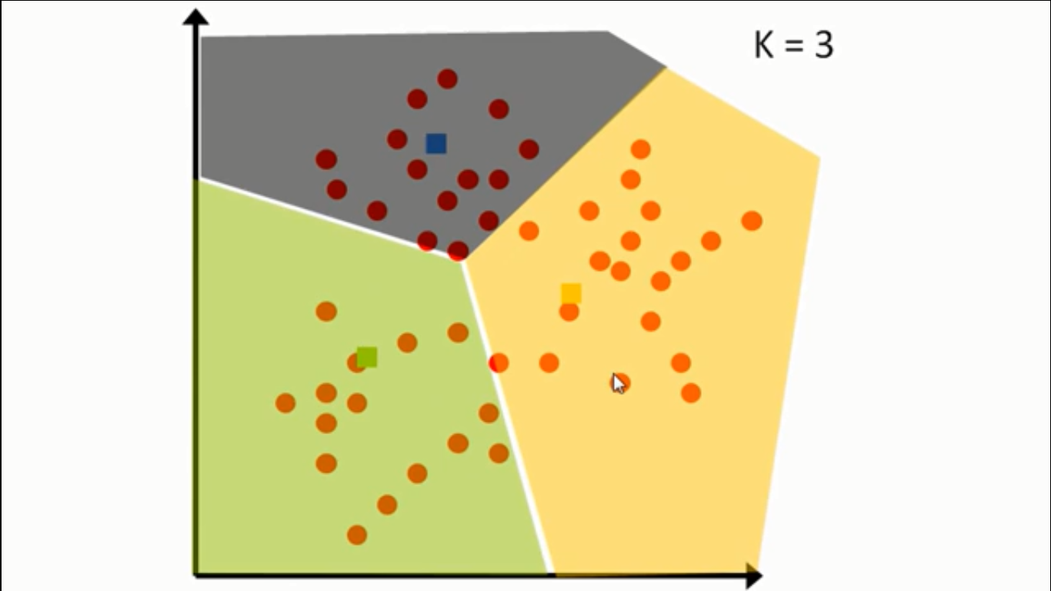
K-means
k-means clustering aims to partition n observations into k clusters in which each observation belongs to the cluster with the nearest mean, serving as a prototype of the cluster
KMeans(n_clusters=8, n_init=10, n_jobs=1)
n_init: Number of time the k-means algorithm will be run with different centroid seeds

Slide 15
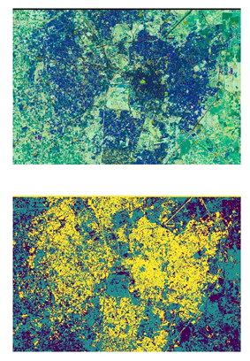
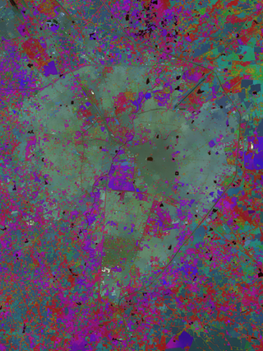
K-means Results

Slide 16
Mean Shift
Mean shift filtering is a data clustering algorithm commonly used in computer vision and image processing. For each pixel of an image (having a spatial location and a particular color), the set of neighboring pixels (within a spatial radius and a defined color distance) is determined. For this set of neighbor pixels, the new spatial center (spatial mean) and the new color mean value are calculated. These calculated mean values will serve as the new center for the next iteration. The described procedure will be iterated until the spatial and the color (or grayscale) mean stops changing. At the end of the iteration, the final mean color will be assigned to the starting position of that iteration

Slide 17
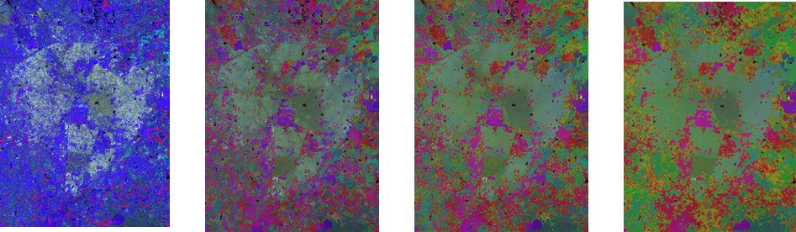
Mean Shift Results
Down Sampled by:
0 1 2 3

Slide 18
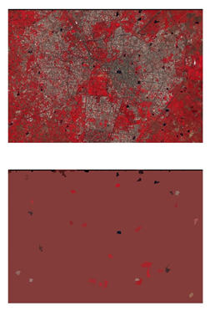
N-Cut (Graph-Cut)

Slide 19
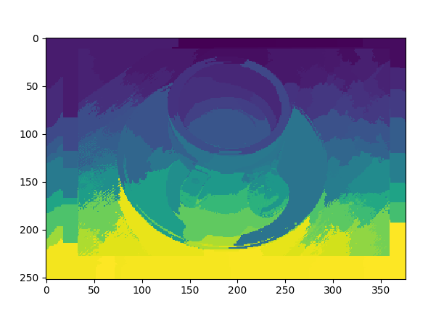
Watershed

Slide 20
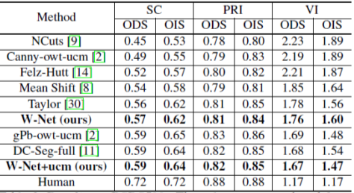
Discussion
DBSCAN: clustered only water bodies
K-mean: loss of data
Mean shift: overall good result
N-cut: poorest result (time complexity is too high)
watershed: not good for this dataset
Reference [1]

Slide 21
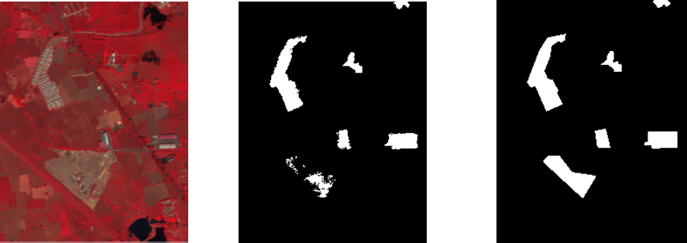
Output of RG on Mean Shift & Raw Image
As of now, step 2 has directly been performed on raw image. But after tweaking the parameters, output of mean shift can be used.

Slide 22
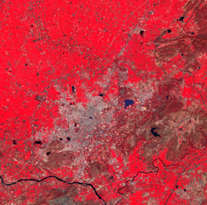
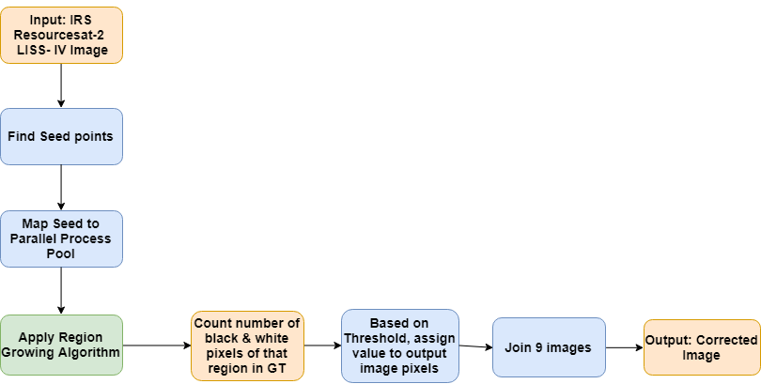
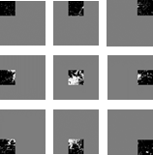
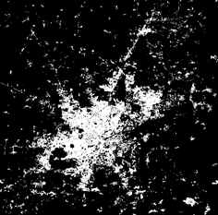
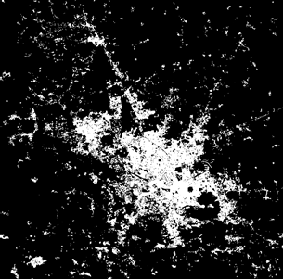
Methodology of step-2

Slide 23
Region Growing Algorithm

Slide 24
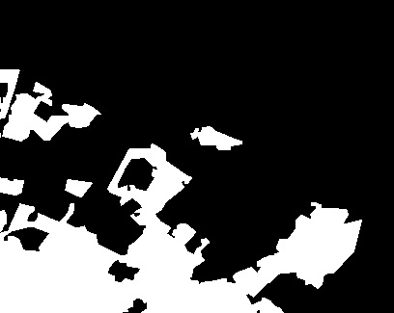
Region Growing Video

Slide 25
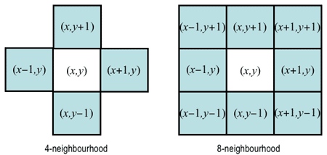
Region Growing
Group pixels or sub-regions into larger regions when homogeneity criterion is satisfied (assumed criterion is a range of pixel value in all 3 bands)
Region grows around the seed point based on similar properties (grey level, texture, color) (9 seed points have been assumed, 9 parallel processes have created for faster execution)
It is better in noisy image where edges are hard to identify

Slide 26
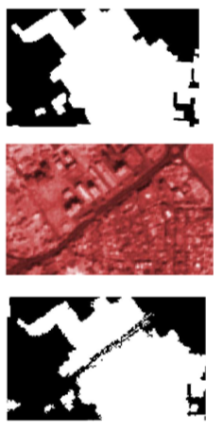
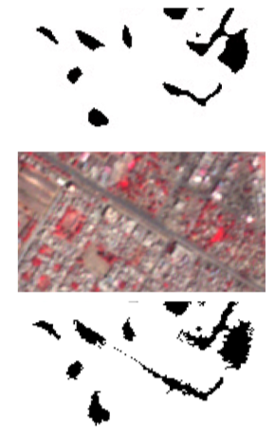
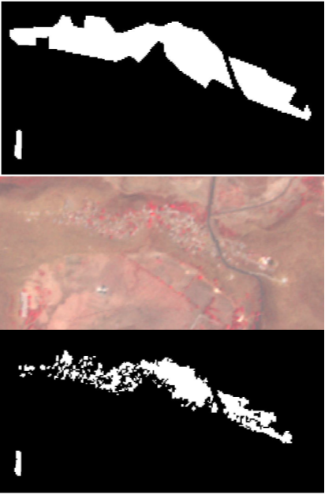
Results
GT
Input
Output
Of RG
Vadodara City
Sagar City
Jabalpur City

Slide 27
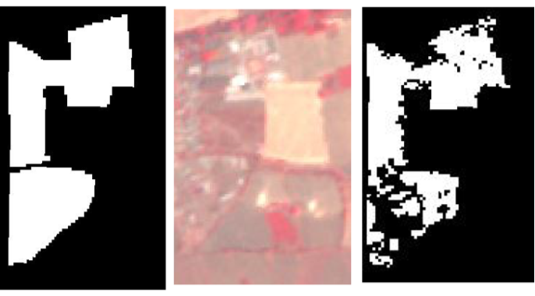
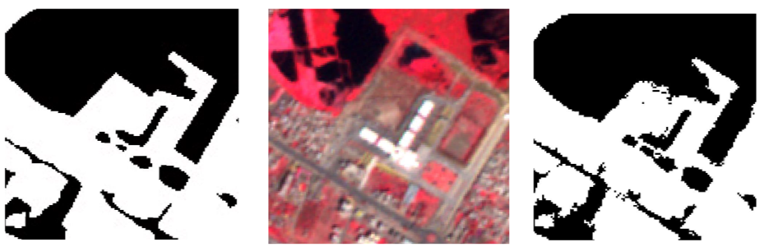
Results
GT Input Output
Sagar City
Jabalpur City

Slide 28
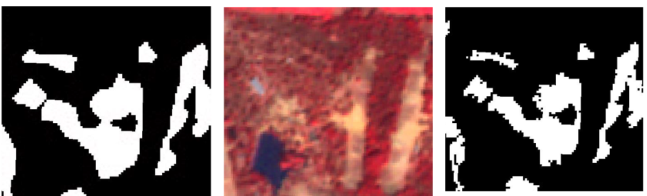
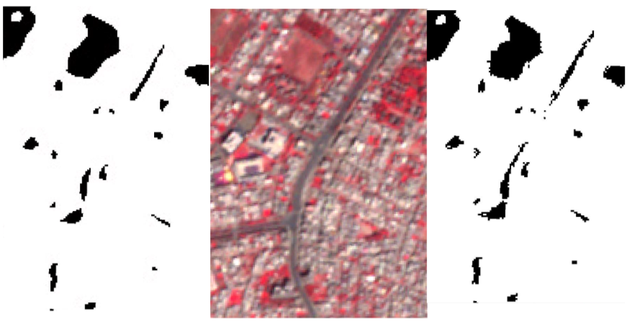
Results
GT Input Output
Jabalpur City
Jabalpur City

Slide 29
Conclusion
Thus, I implemented and analyse different unsupervised image segmentation techniques such as DBSCAN, K-means, Mean shift, N-cut and Watershed
Mean Shift algorithm gave the best output after stage-1, but needs improvement in selection of hyperparameters so, that it can perform equally good on stage-2
As of now, RGB Threshold of 14 and B&W pixel voting of 50% gives best result

Slide 30
Future Work
Twiking of Hyperparameters such as RGB Threshold value and Voting value of B&W pixels for better accuracy
Implementation of Progressive Thresholding technique
Feedback output image as new GT
Voting Value
(Fix 50%)
GT
Region Growing
RGB Threshold
(10,15,20)
Input
Output

Slide 31
References
[1] Xia, Xide, and Brian Kulis. "W-Net: A Deep Model for Fully Unsupervised Image Segmentation." arXiv preprint arXiv:1711.08506 (2017).
[2] Shi, Jianbo, and Jitendra Malik. "Normalized cuts and image segmentation." IEEE Transactions on pattern analysis and machine intelligence 22.8 (2000): 888-905.
[3] Zhou, Yong-mei, Sheng-yi Jiang, and Mei-lin Yin. "A region-based image segmentation method with mean-shift clustering algorithm." Fuzzy Systems and Knowledge Discovery, 2008. FSKD'08. Fifth International Conference on. Vol. 2. IEEE, 2008.

Slide 32
Thank you!

